Slide 1
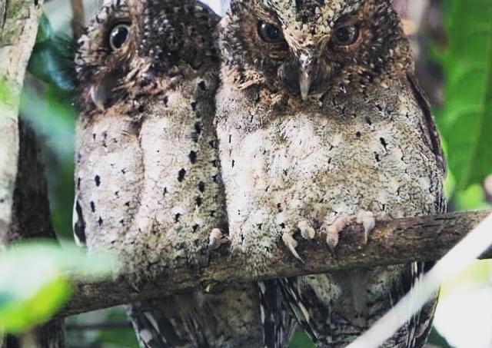
LEVERAGING MACHINE LEARNING TO COMBAT BUSHMEAT POACHING
AND ILLEGAL LOGGING IN ARABUKO-SOKOKE FOREST RESERVE, KENYA

Slide 2
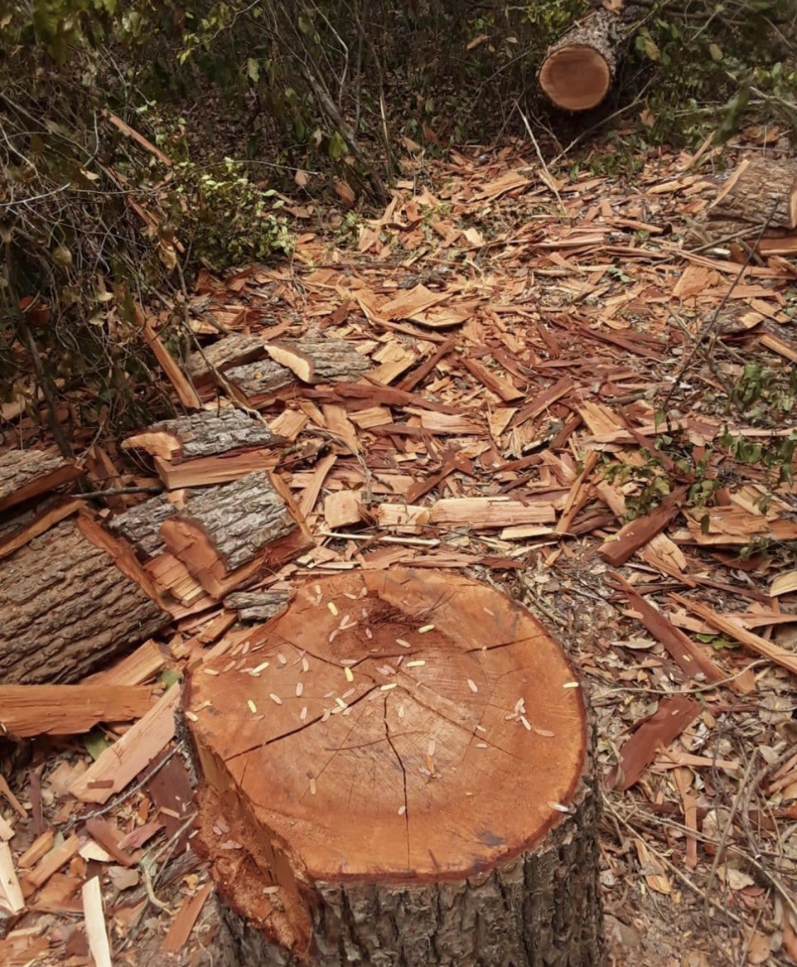
Problem Statement
The Arabuko-Sokoke Forest (ASF), designated as a UNESCO Man and Biosphere Reserve and recognized as a biodiversity hotspot, faces persistent threats from illegal poaching and logging activities. These threats are exacerbated by the significant demand for forest products from nearby urban centers, including Malindi, Watamu, Kilifi, and Mombasa. Additionally, the presence of over 200,000 people residing at the forest boundary further intensifies these challenges, endangering the forest ecosystem's integrity, biodiversity, and the livelihoods of local communities. Effective strategies are imperative to combat the illegal exploitation of forest resources and to safeguard the ecological and socio-economic value of ASF.

Slide 3
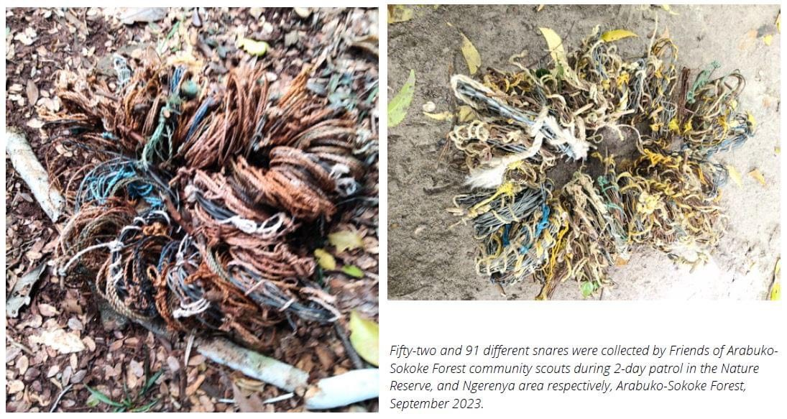
Objectives
General Objectives:
To leverage machine learning techniques for combating illegal poaching and logging activities in the Arabuko-Sokoke Forest (ASF) by analyzing historical data to develop predictive models that guide conservation interventions and law enforcement strategies.
Specific Objectives:
Utilize time series analysis techniques, including ARIMA, VAR, and XGBoost, to develop predictive models for forecasting illegal logging and bushmeat poaching activities in ASF.
Identify trends and patterns of illegal logging and poaching activities in ASF through comprehensive analysis of historical data.
Compare the performance of different machine learning algorithms, including ARIMA, VAR, and XGBoost, in predicting and understanding illegal logging and poaching patterns in ASF.
Evaluate the practical implications of the predictive models in informing conservation strategies and policy decisions aimed at safeguarding ASF's ecological integrity and supporting local communities.

Slide 4
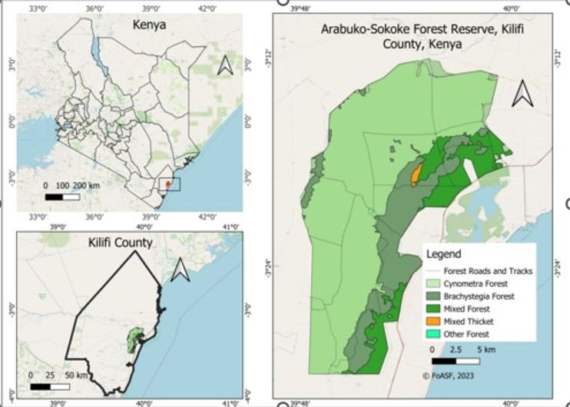
Research Questions
How effectively can time series analysis techniques, such as ARIMA, VAR, and XGBoost, forecast illegal logging and bushmeat poaching activities in ASF based on historical data?
What are the trends and patterns illegal logging and poaching activities in ASF, as revealed by the analysis?
Among the utilized machine learning algorithms, namely ARIMA, VAR, and XGBoost, which demonstrate the highest efficacy in predicting and understanding illegal logging and poaching patterns in ASF?
How can the actionable insights derived from these predictive models contribute to the development and implementation of effective conservation strategies and policies for ASF, considering ecological preservation and community livelihoods?

Slide 5
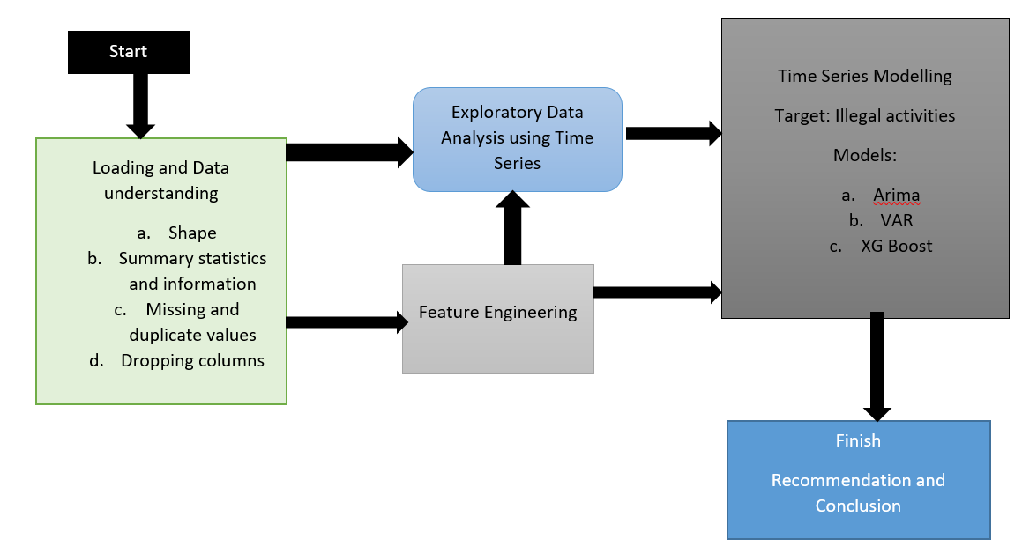
Methodology
Source of data: Survey 2018-2024
Tool used: SMART tech
Data description: 18761 observations; total 28 columns)
Numerical and categorical data types

Slide 6
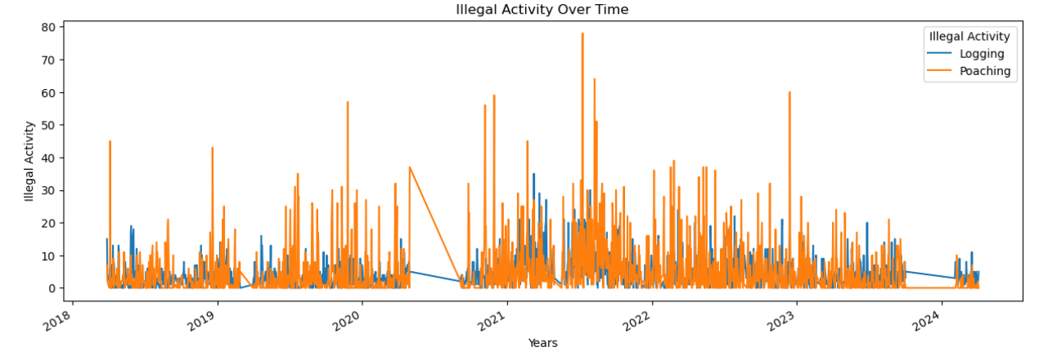
Exploratory Data Analysis
The trends and patterns in illegal activities from 2018 to 2024.

Slide 7
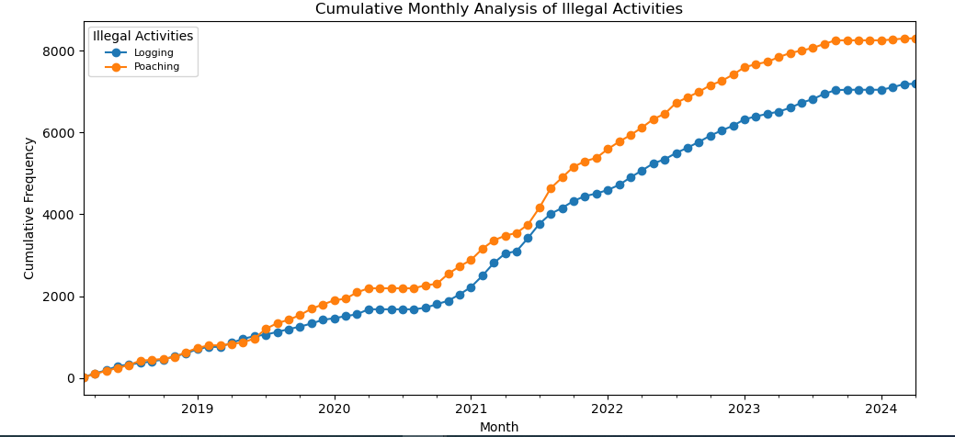
Positive trend; the illegal activities increases with time (2018 to 2024)

Slide 8
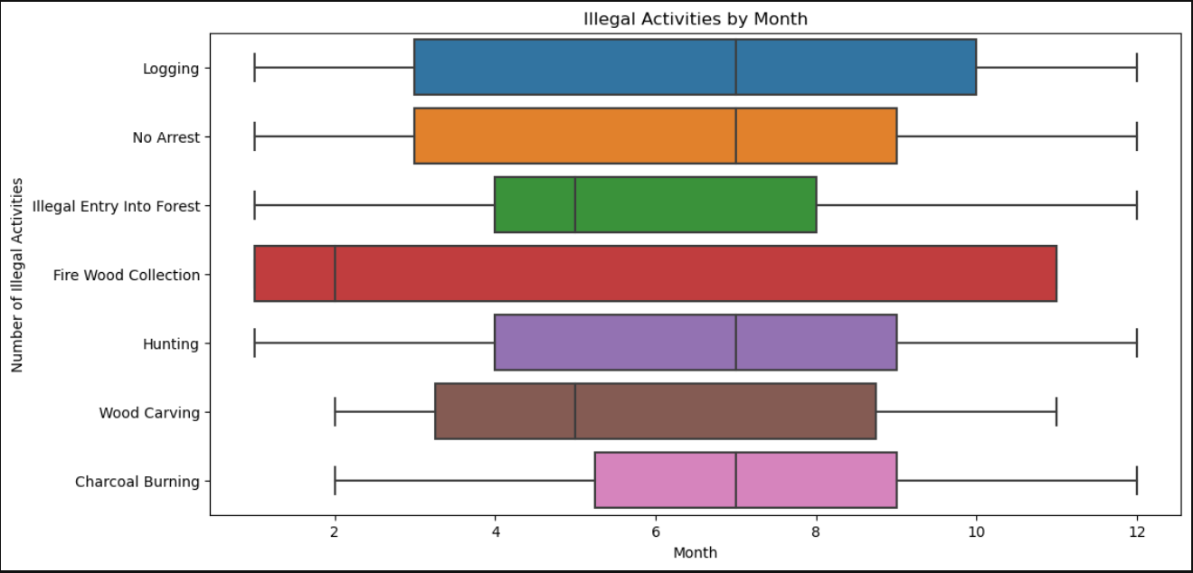
Monthly Quartiles and Median for Arrest of Illegal Poaching and Logging in Arabuko Sokoke Forest

Slide 9
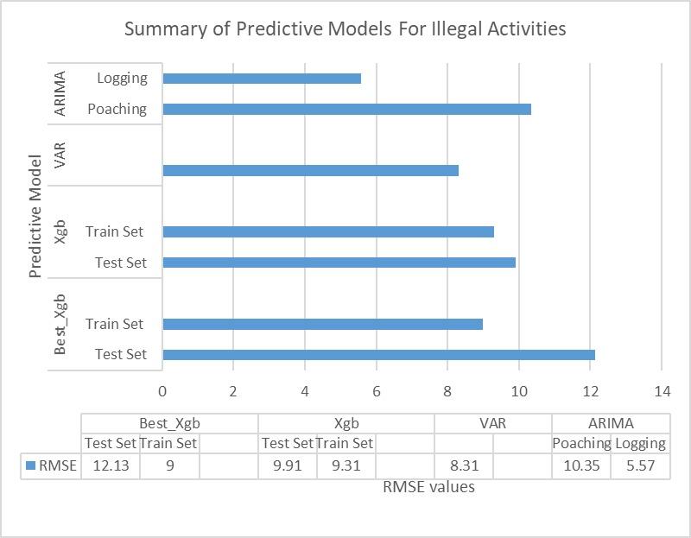
Model Performance
XGBoost regressor model exhibits comparable performance
VAR model shows moderate RMSE
and ARIMA model: relatively low RMSE
Best_Xbg performs better with less overfitting

Slide 10
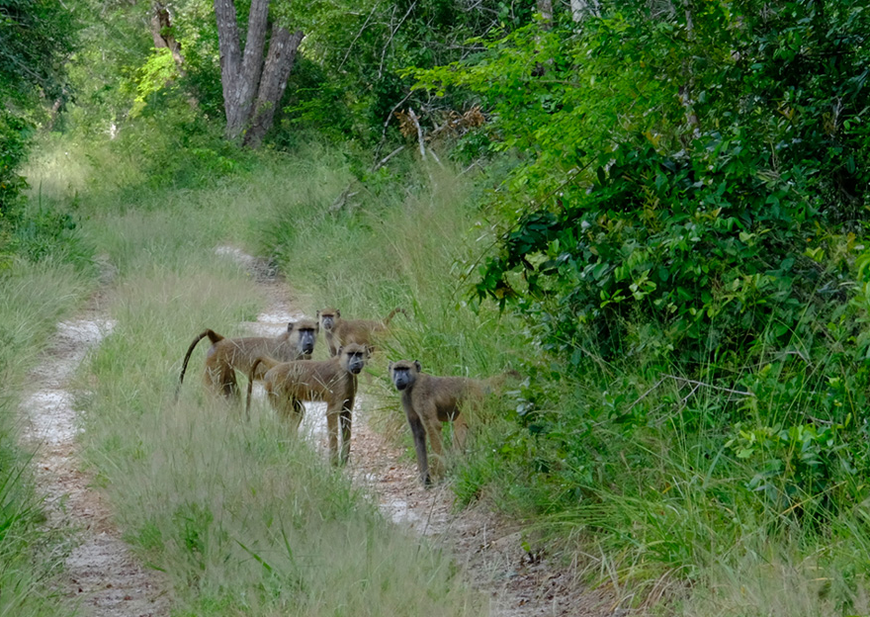
Model Performance
The ARIMA model demonstrates relatively low RMSE values, indicating good predictive performance for both logging and poaching activities
The VAR model shows moderate RMSE, suggesting reasonable predictive accuracy for capturing the relationship between logging and poaching activities.
The XGBoost regressor model exhibits comparable performance with the VAR model, providing reliable forecasts for logging and poaching incidents in the Arabuko-Sokoke Forest

Slide 11
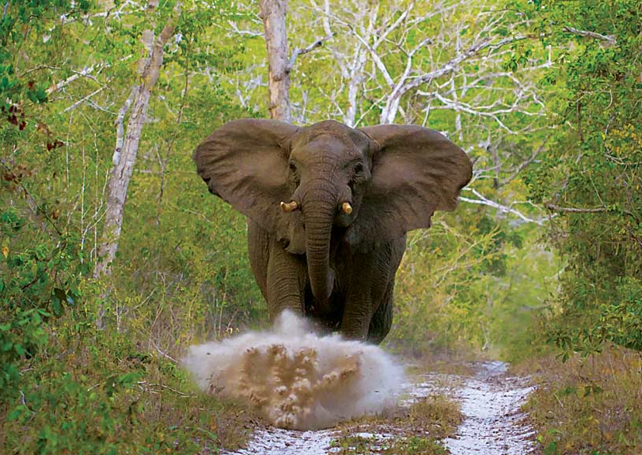
RECOMMENDATIONS
Utilize XGBoost for Forecasting: XGBoost is recommended for forecasting illegal logging and poaching due to its superior accuracy over ARIMA and VAR models.
Monitor and Respond to Trends: Continuously monitor trends in illegal activities and adapt strategies accordingly, considering seasonal patterns.
Enhance Conservation Strategies: Develop targeted conservation strategies based on predictive model insights to address illegal activities and support ecological preservation and community livelihoods.
Policy Recommendations: Use findings to inform policies that safeguard ASF's ecological integrity, focusing on sustainable practices and community engagement.
Collaborative Efforts: Foster collaboration among stakeholders to enhance conservation efforts and combat illegal activities.
Continuous Evaluation: Regularly evaluate strategies and adapt based on new insights for long-term conservation success.
NOTE:
By refining the predictive models and enhancing their accuracy in forecasting illegal activities, stakeholders can proactively implement targeted conservation strategies and allocate resources more efficiently to mitigate the threats posed to the Arabuko-Sokoke Forest ecosystem and support the livelihoods of local communities.

Slide 12
CONCLUSION
The integration of machine learning techniques into conservation planning and management offers a promising approach to combat illegal activities threatening the Arabuko-Sokoke Forest. By harnessing the power of predictive analytics, stakeholders can work towards a sustainable future for ASF, preserving its biodiversity and ecosystem services for generations to come.
"In harnessing the power of predictive analytics, we chart a course towards a sustainable future for the Arabuko-Sokoke Forest, preserving its biodiversity and ecosystem services for generations to come”
― Mlati,Philip, Stella, Ahmed, and Allan

Slide 13
Philip Mweri
Allan Omolo
Mlati Ochieng
Ahmed Haji
Stella Ndegwa
Data Scientists

